Slide 1
PROPELPAD // WHITE STORE NETWORK
Delivering fresh products,
every single time.
How Propelpad’s White Store network powers hygienic, fast, and reliable fulfilment for frozen and specialty food brands on Zomato & Swiggy.
propelpad.in // 9 WHITE STORES // MUMBAI & THANE

Slide 2
02 //
Not dark stores. Not forgotten warehouses.
We Call Them White Stores.
Every Propelpad facility is clean, bright, and maintained to brand standards, because a premium brand deserves a premium environment, not a warehouse that happens to have Wi-Fi and a delivery bag.

Slide 3
03 //
Food-Commerce Is Where Your Customers Are.
India’s online food delivery market is on track to nearly double in size by 2031 turning desserts and snacking into an impulse, on demand purchase, not a planned one.
The opportunity is massive. But simply being listed on Swiggy or Zomato is not enough.
01
02
03
10-30 Minute Window
$61B+ Delivery Market
An Untapped Vertical
Food-commerce turns desserts and snacks into an impulse, on-demand purchase - not a planned one.
India’s online food delivery market is on track to nearly double in size by 2031, industry estimates suggest.
Frozen and specialty food is still underrepresented on quick commerce - early movers claim shelf position first.

Slide 4
04 //
Numbers That Set Us Apart.
Operations excellence, measured daily across every Propelpad white store.
01
02
4.4★ Average Rating
95% Order Accuracy
Consistently maintained across all Propelpad white stores on Zomato & Swiggy.
Food Order Ready rate - orders prepared accurately and on time, every time.
03
04
99.8% Store Uptime
1:38 Prep Time
Near-perfect platform availability - your store is open when customers order.
Order received to packed in under 2 minutes - industry-leading, measured across all 9 stores.

Slide 5
05 //
We Don’t Just Stock Your Brand.
We Help You Sell More Of It.
Propelpad’s SKU intelligence engine tracks performance per outlet and time-of-day, so every white store always stocks exactly what moves.
01
SKU Performance Insights
Which flavours and SKUs sell fastest - tracked per outlet and time-of-day, so you always stock what moves.
02
Low-Velocity SKU Alerts
Identify slow-movers before they approach expiry - zero waste, every time.
03
Demand Window Mapping
Weekends, evenings, seasonal peaks - we know exactly when to push each SKU.
04
Sell-Through Matching
Reorder cycles matched to real velocity, so stockouts never cost you a sale.

Slide 6
06 //
Dark Store vs. White Store
How the two compare, side by side.
Dark Store
White Store
Dim & Dusty
Bright & Spotless
Dim, disorganised, and built around square footage - not food safety.
Maintained to brand standards, not just swept once a week.
What this looks like:
What this looks like:
• Inventory chaos, no visible SOPs
• Brand-compliant, category-specific storage
• Reactive restocking, frequent stockouts
• Predictive, data-driven buying cycles
• Generic handling for every category
• FSSAI-compliant, CCTV-monitored, always
• Opaque operations, no data access
• Full data transparency, every single order

Slide 7
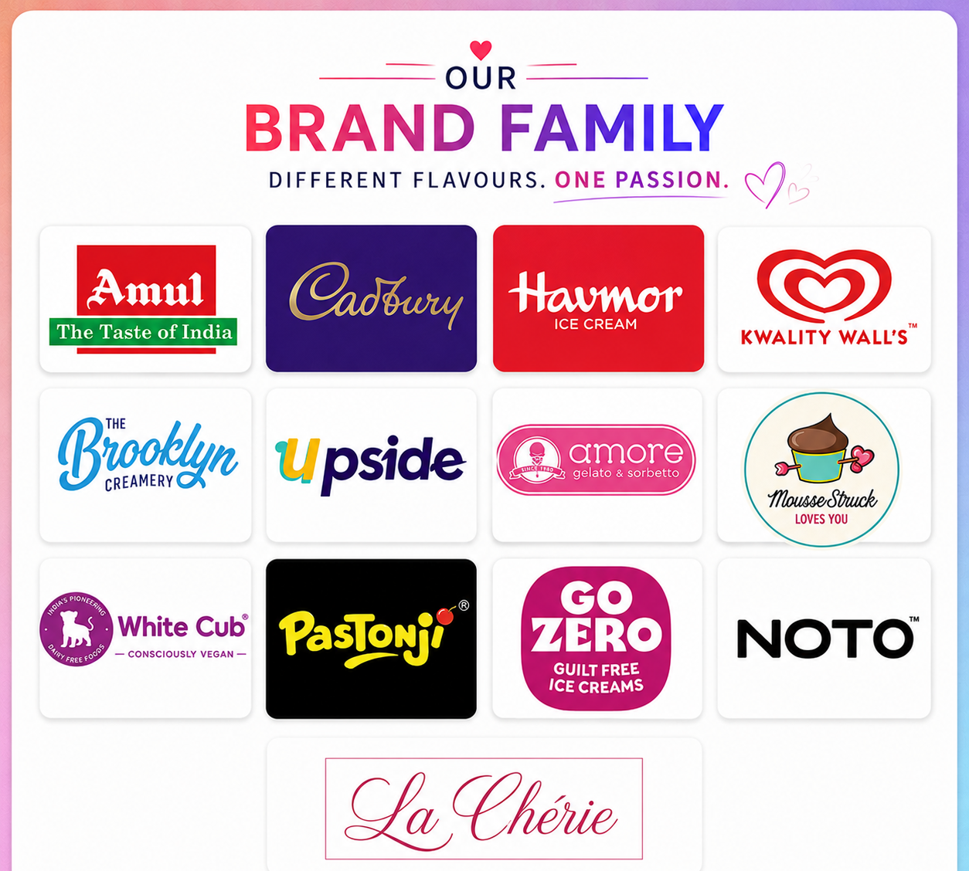
07 //
Our Brand Family.
13+ brands. One white store network.
13+ leading F&B brands - from heritage dairy to guilt-free indulgence - already trust Propelpad’s white store network.

Slide 8
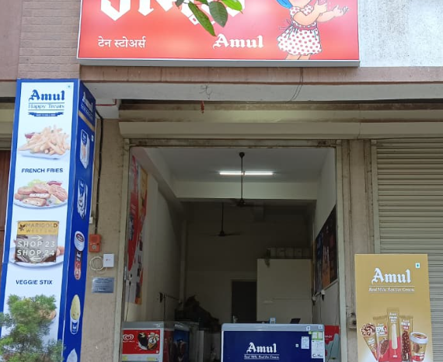
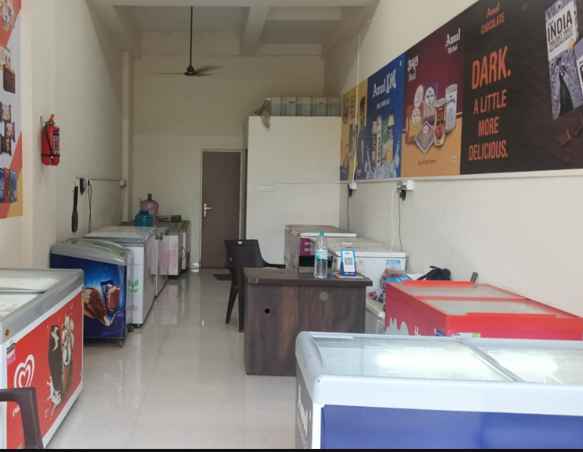
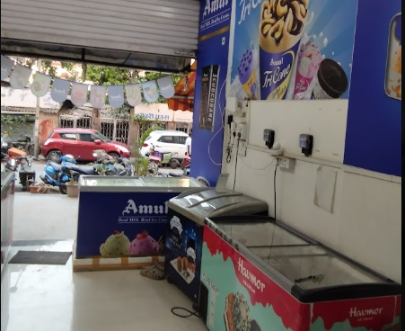
08 //
Inside Our White Stores.
Not dark stores. Not forgotten warehouses. Every facility is clean, bright, and built to one hygiene standard - always.
FSSAI
TEMP-CTRL
PPE
CCTV-MONITORED
BATCH
REAL-TIME QC
FSSAI-compliant food safety licensing, temperature-controlled storage, and real-time quality checks before every order leaves the store.

Slide 9
09 //
Buying Efficiency, Built In.
The other half of inventory intelligence: buying exactly enough, exactly on time.
01
Zero Over-Buying
Orders matched precisely to actual sell-through - every rupee converts.
02
Weekly Velocity Cadence
Buying frequency tuned to your exact sales rhythm, SKU by SKU.
03
Seasonal Forecasting
Festivals, summer peaks, and weekend surges - demand modelled in advance.
04
Cold-Chain Batch Sequencing
Older batches move first, automatically, without manual tracking.
05
Perfect Stock Depth
Maximum sales per square foot, with zero waste - always.
The result: maximum sales per square foot. Zero waste. Perfect stock depth, every single day.

Slide 10
10 //
5 Reasons Your Brand Belongs Here.
01
Premium-Grade Cleanliness
Store environments that match your product's prestige - every shelf, every freezer, every day.
02
4.4★ Average Rating
Drives platform visibility and repeat orders on both Zomato and Swiggy.
03
Sub-2-Minute Pack Time
Ensures your product is dispatched at peak freshness, order after order.
04
SKU Intelligence
Maximises your best-selling variants and eliminates waste automatically.
05
99.8% Uptime
Your store is never dark during peak demand - online exactly when customers order.

Slide 11
11 //
Mumbai, Fully Covered.
9 strategically located white stores across Mumbai and Thane - Dahisar, Vakola, Santacruz, Chembur, Oshiwara, Hiranandani Estate, Khopat (Thane West), Fort, and Versova.
9 STORES · MUMBAI + THANE · 1 PARTNER
01
02
03
Wider Addressable Market
Redundancy & Resilience
Hyperlocal Demand Data
Each store unlocks thousands of premium-consumer households across the highest-density areas in Mumbai and Thane.
If one store goes offline, orders route to the nearest available location. Your brand never disappears from the platform.
We track what sells where, so your brand can run location-specific campaigns, not just city-wide promotions.

Slide 12
13 //
Taking White Stores Across India.
Propelpad's white store model is proven in Mumbai. 19 new stores are already planned across 5 cities. Data picked these locations, not intuition.
Expansion Timeline: FY26-27
19 New Stores.
Bangalore
6 Stores · Q2
Across Bangalore, Delhi NCR,
Hyderabad, Kolkata & Pune.
Delhi NCR
5 Stores · Q2
Hyderabad
3 Stores · Q3
• Same playbook that built 9 stores across Mumbai & Thane
Kolkata
3 Stores · Q3
• Data-led site selection - highest-demand food-ordering pockets only
+ 2 more stores launching in Pune, Q3 FY26-27.
• Direct site visits, category compliance & documentation handled for you
• One playbook, one partner, every city we enter

Slide 13
Ready to bring your brand to every doorstep?
Let's talk.
Shanu Singh
Gyan Menon
Mumbai City Lead
Co-Founder
Email: shanu.singh@propelpad.in
Email: gm@propelpad.in
Phone: +91 8237981485
Phone: +91 8424048334

